Slide 1
Impact of Heat on Health of Rickshaw Pullers

Slide 2
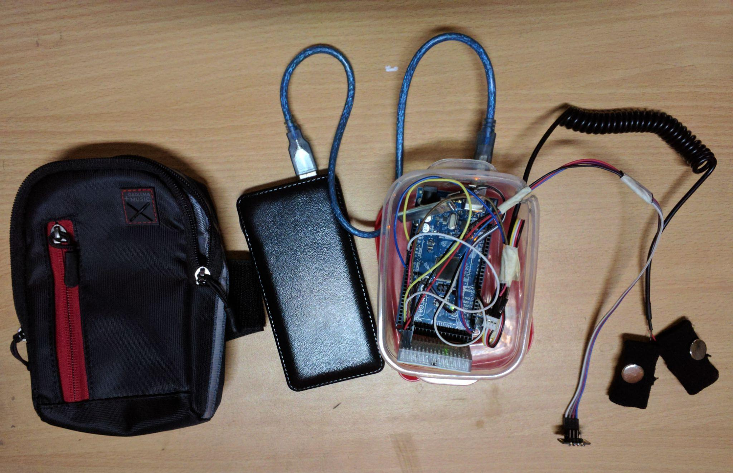
Power cable
Bluetooth module
Handbag
Galvanic skin response (GSR)
Electrodermal conductivity
Power source
Arduino Mega 2560
Pulse Oximetry
BPM
Oxygen saturation
Body temperature
Heath sensing module

Slide 3
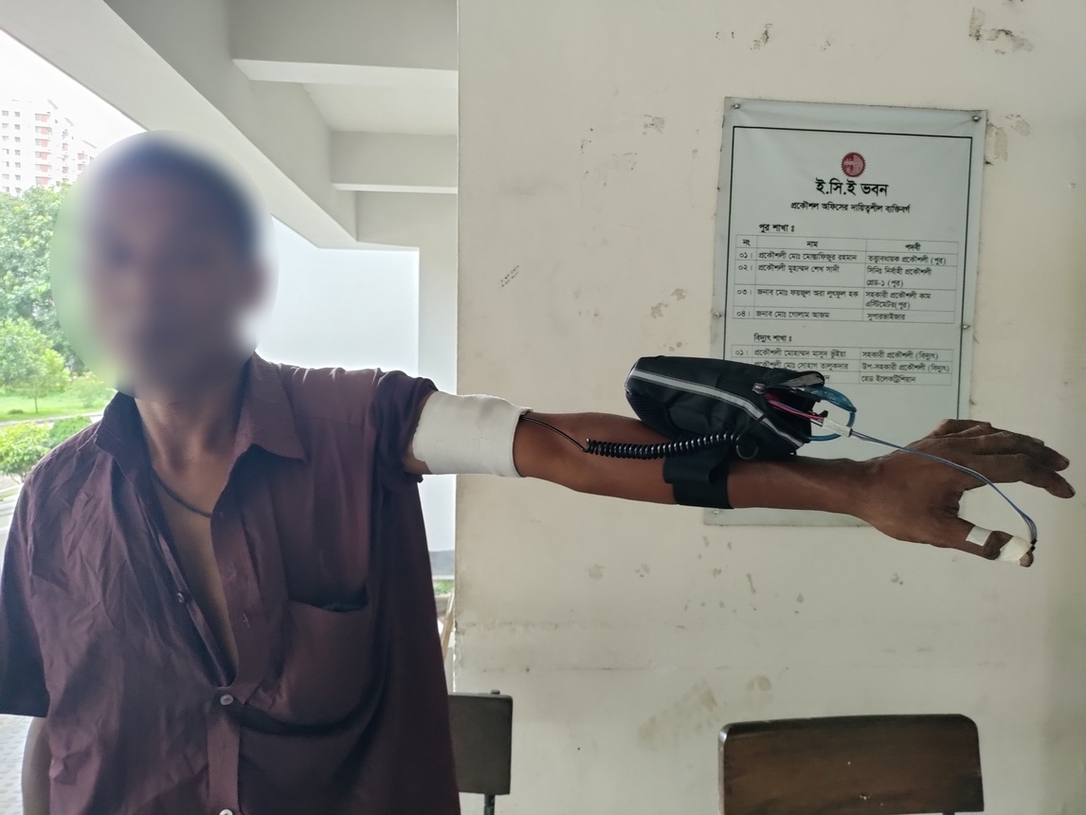
GSR sensor on upper arm
Rounded by a clinical standard band
2. Pulse oximetry on thumb
Mounted with masking tape
3. Other system components inside a handbag
Mounted with lower arm
Deployment of heath sensing module

Slide 4
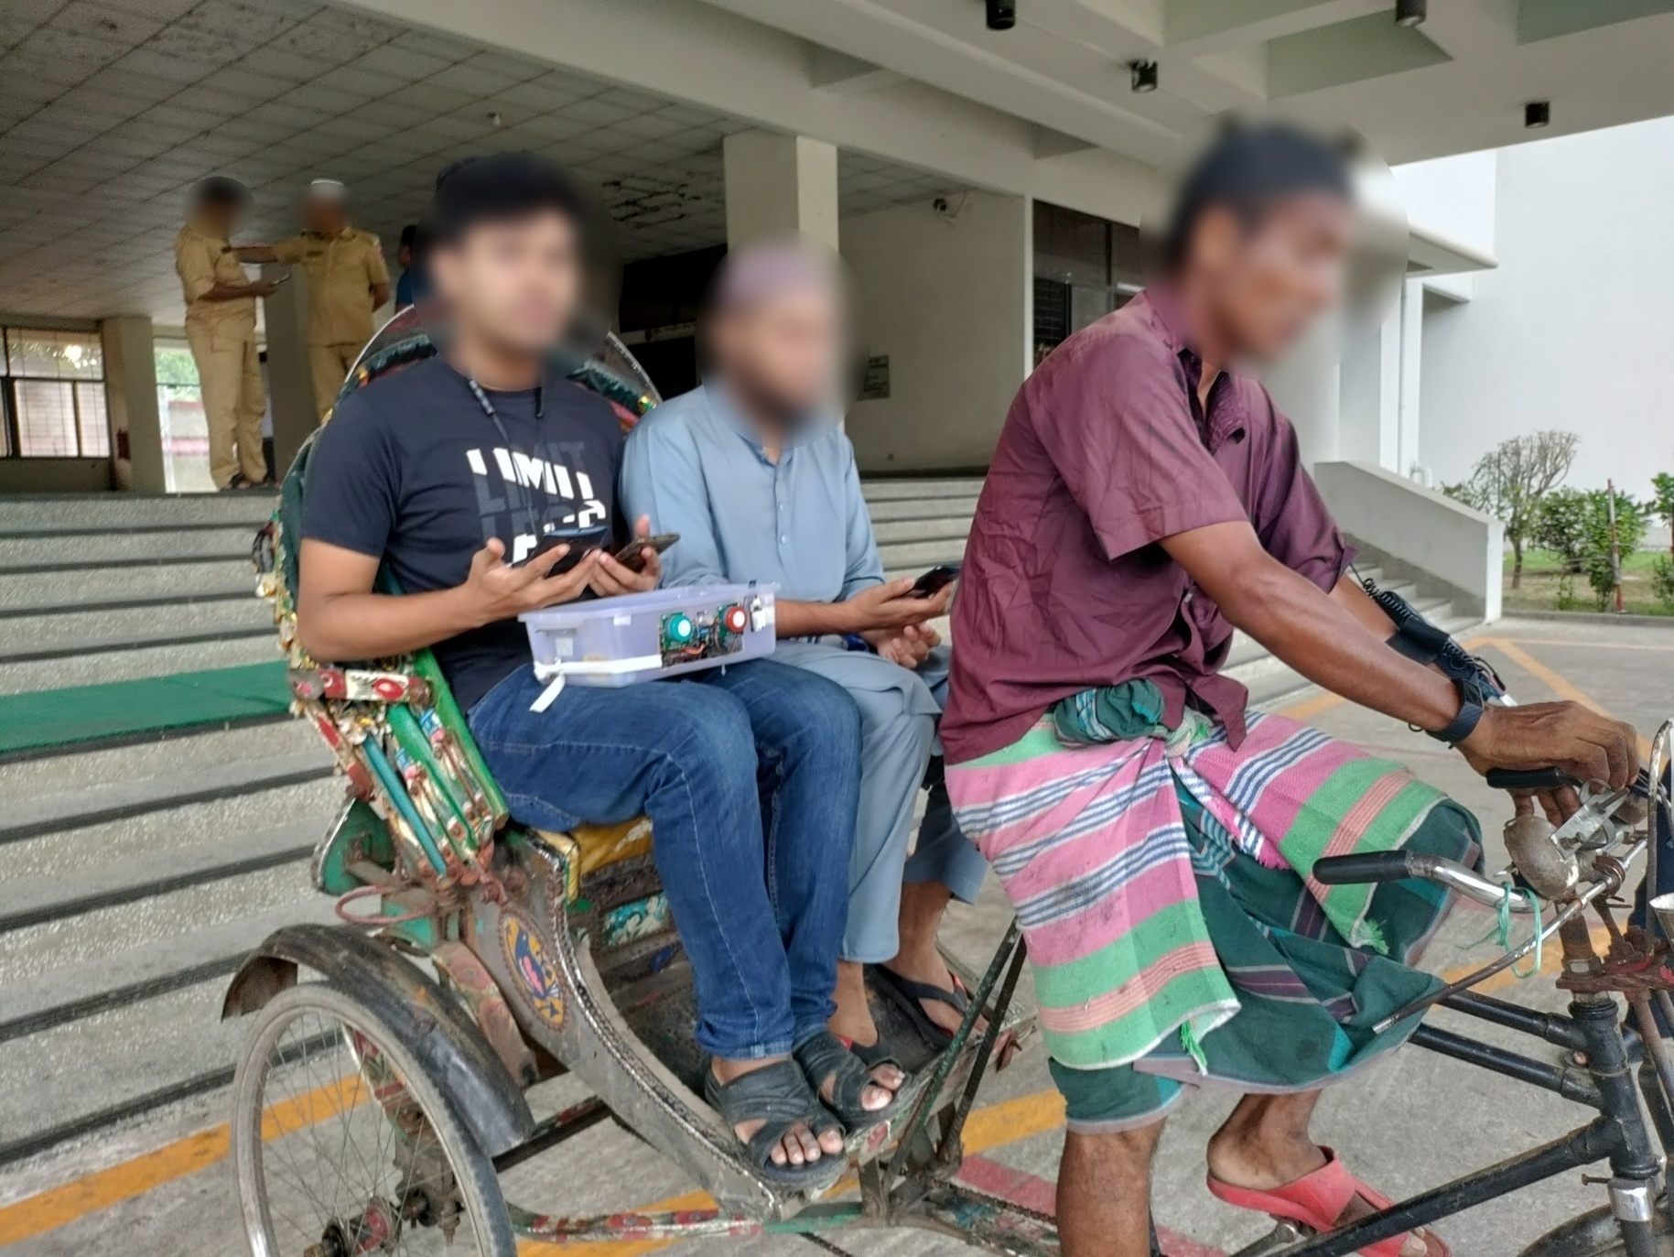
Health sensing module
Left hand
GSR
Pulse oximetry
- Right hand
- Fitbit
Environment sensing module on back sit of rickshaw
Integration of all system components

Slide 5
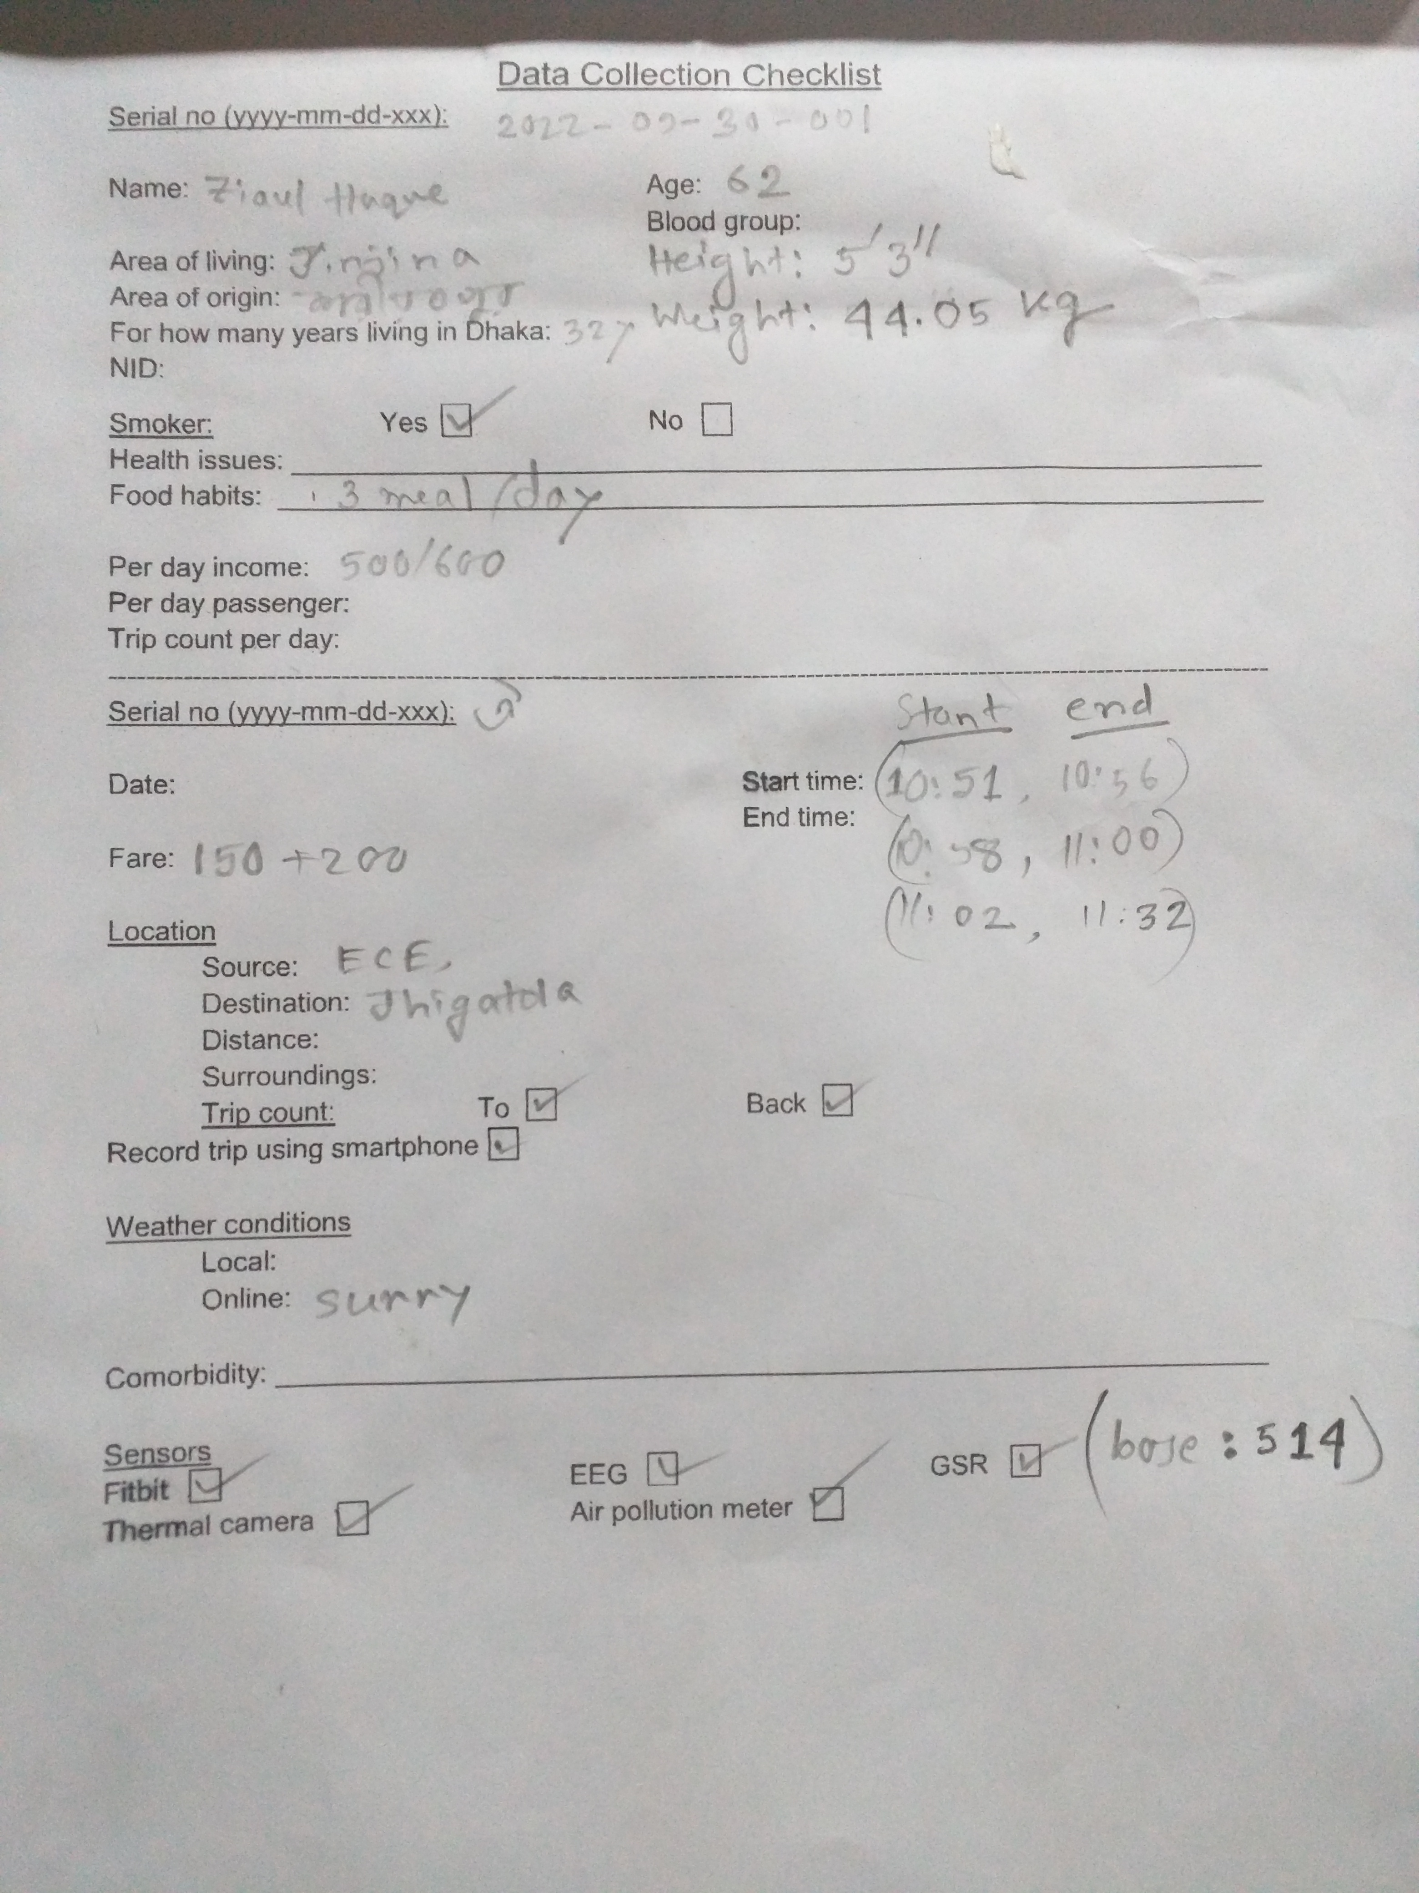
Trip 1 (30 Sept, 2022)
Age = 62
Weight = 44 kg
Height = 160 cm
BMI = 17.2 kg/m2
Active sensors:
All environmental sensors
GSR

Slide 6
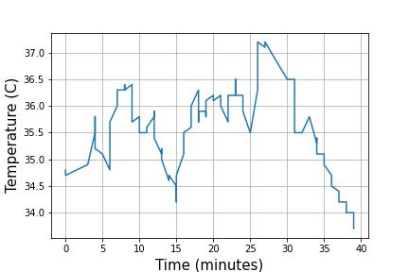
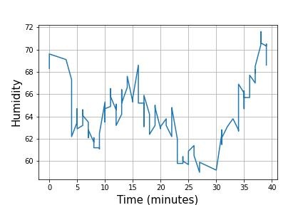
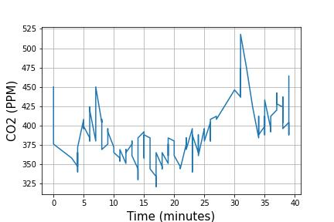
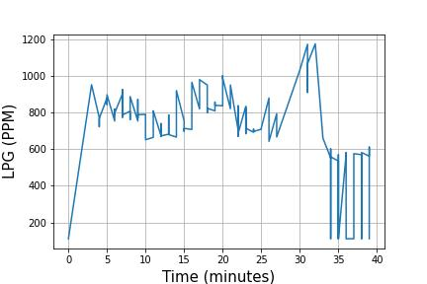
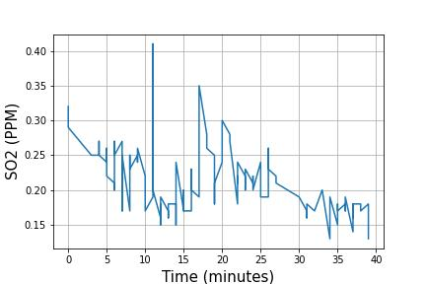
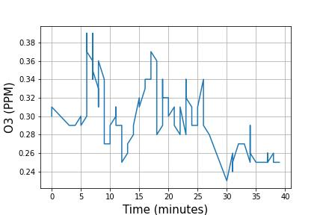
Figure: Change in environmental parameters with time

Slide 7
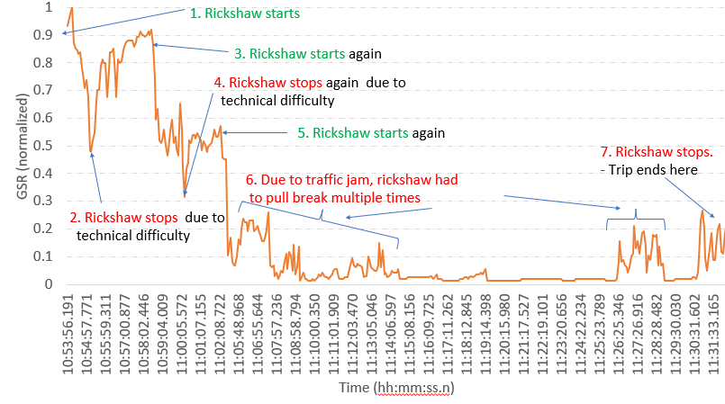
Figure: Change in health parameters with time

Slide 8
Figure: Correlation between environmental and health parameters

Slide 9
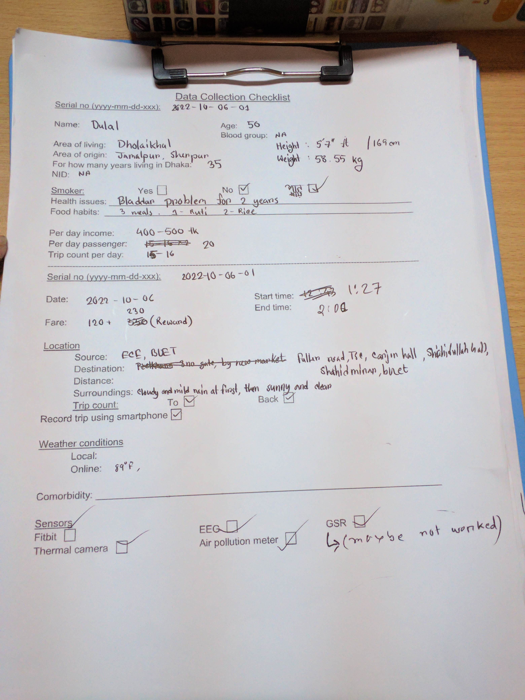
Trip 1 (06 Oct, 2022)
Age = 50
Weight = 68.55 kg
Height = 170 cm
BMI = 20.3 kg/m2
Active sensors:
All environmental sensors
Heart rate
Body temperature
Thermal camera
Sampling rate
Environmental sensors: 9 s per sample
Health sensors: 11 s per sample

Slide 10
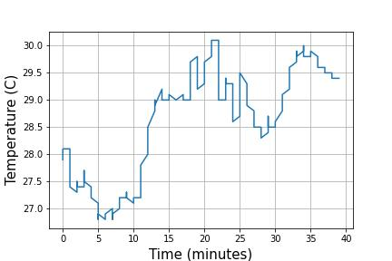
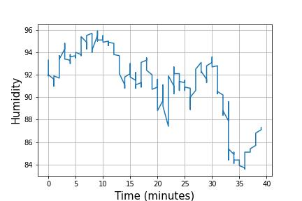
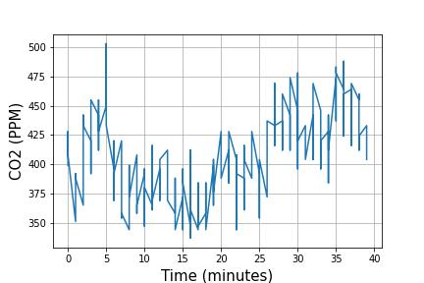
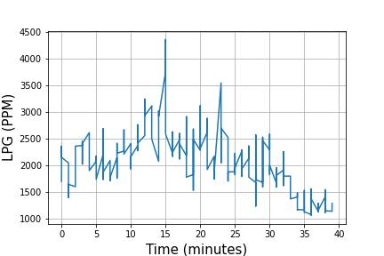
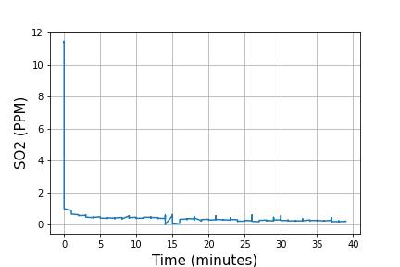
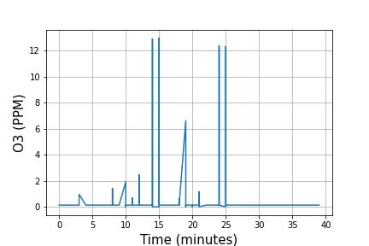
Figure: Change in environmental parameters with time

Slide 11
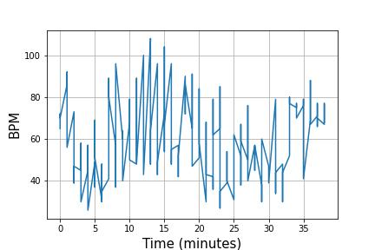
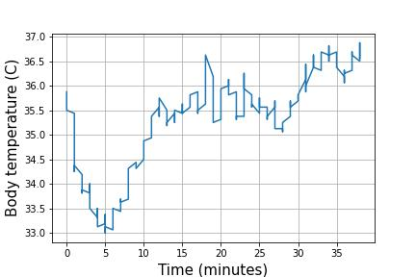
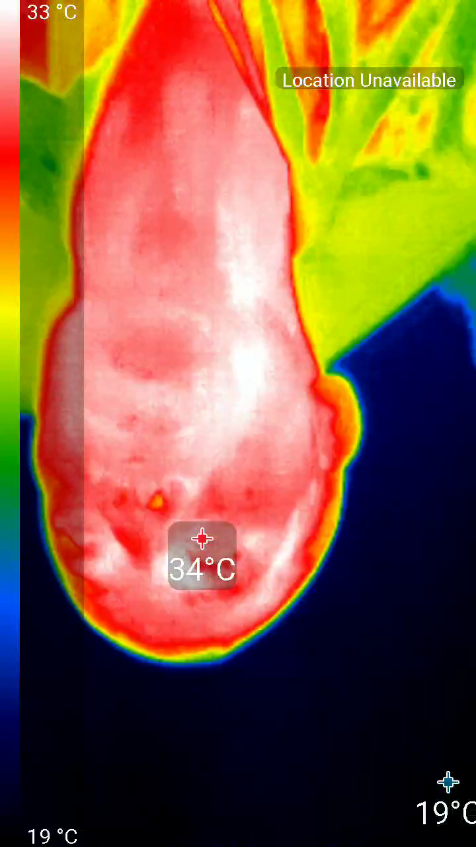
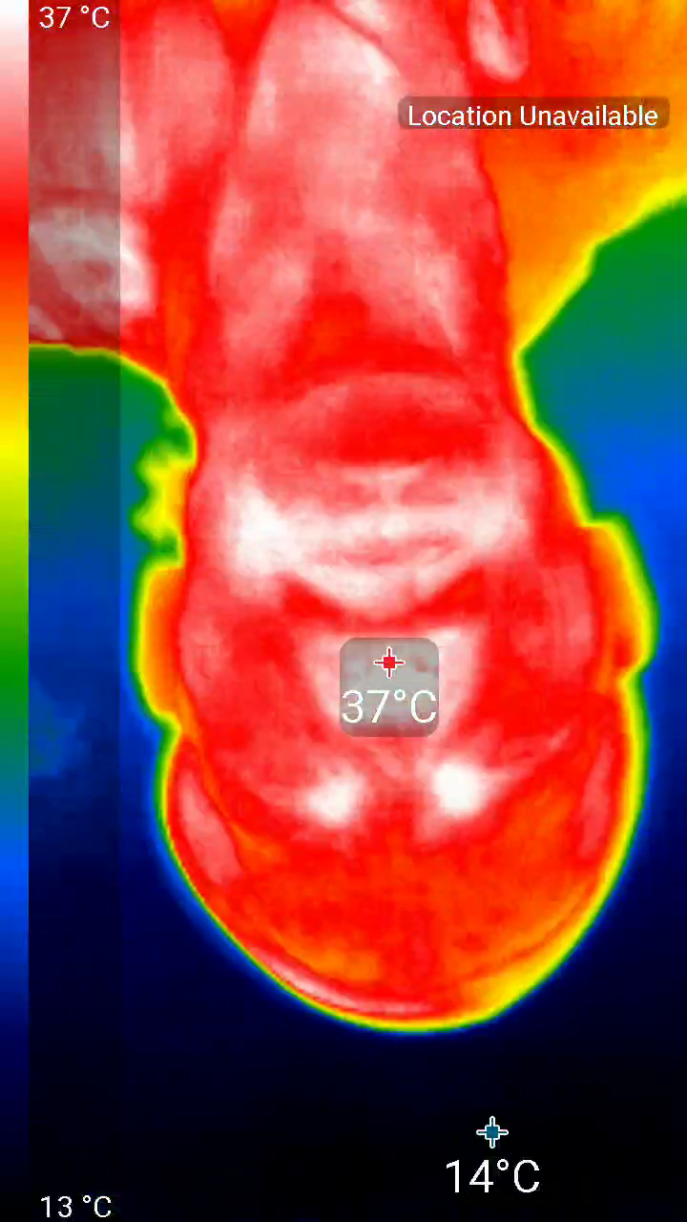
Start of trip (34 °C)
End of trip (37 °C)
Figure: Change in health parameters with time

Slide 12
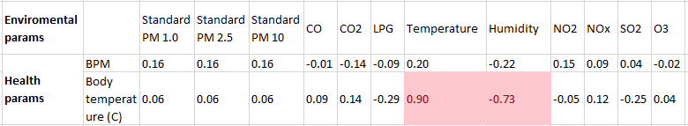
Figure: Correlation between environmental and health parameters

